Slide 1
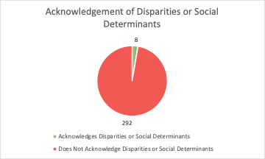
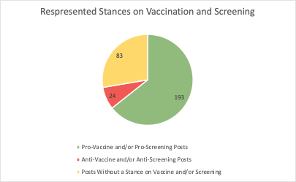
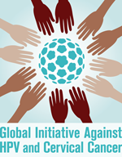
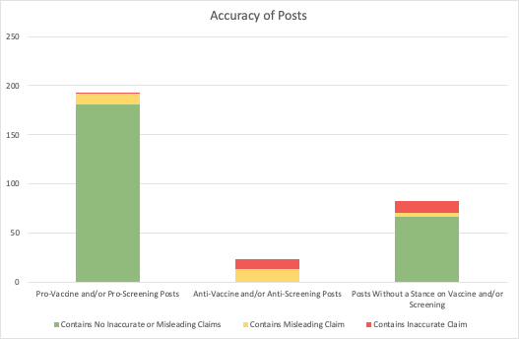
Instagram as a Tool for Increasing Awareness for HPV Vaccination and Cervical Cancer Screening: A Content Analysis of Related Posts
Results:
Elise Vance*^{1,3} and Rachel Anderson*^{2,3}
¹ Case Western Reserve University, Cleveland, OH
²University of Massachusetts Medical School, Worcester, MA
³Global Initiative Against HPV and Cervical Cancer
Correspondence: Rachel.Anderson@umassmed.edu or bev12@case.edu
The authors have no disclosures.
Examples of Inaccurate Claims:
HPV vaccine commonly causes death and other serious side effects
HPV can be prevented or cured with “natural” treatments (mushrooms, herbs, stress reduction, diet, turkey tail)
HPV vaccine is being used to deliberately injure and/or infect people
Examples of Misleading Claims:
Recommendations for over-screening
Citations of VAERS reports as evidence of HPV vaccine-related injury
Claims that non-licensed naturopathic providers are equipped to treat HPV
Examples of Content Containing No Inaccurate or Misleading Claims:
Posts providing information on how the HPV vaccine works
Cervical cancer survivors encouraging screening
Introduction:
Cervical cancer remains a leading cause of death in women worldwide despite being almost completely preventable through HPV vaccination, screening, and treatment of precancerous lesions. . Previous research has shown that social media engagement can be effective in increasing HPV awareness¹. As such, healthcare professionals have adopted innovative strategies to use social media to educate broad audiences on the role of vaccination and screening in cervical cancer elimination. With over 1 billion users worldwide, Instagram has been a popular platform for posting about this topic. However; this site also hosts accounts that spread inaccurate and misleading information about HPV and cervical cancer prevention and treatment. Some studies have shown that exposure to such content on social media can lead to lower HPV vaccination rates². In addition, significant racial, ethnic, and socioeconomic disparities in cervical cancer outcomes have been identified³, and the role of social media in perpetuating and/or addressing these disparities is unknown. The aim of this study was to analyze content from popular hashtags that disseminate information about HPV and cervical cancer with particular attention to inclusion of information on disparities and/or social determinants, represented stances on vaccination and screening, and inclusion of inaccurate or misleading claims.
1
11
181
12
4
11
67
13
Methods:
1. Selection of Posts
Top 100 posts from #CervicalCancerAwareness, #HPVawareness, and #HPVprevention.
These hashtags were selected because they are the most commonly used searchable hashtags by HPV and cervical cancer awareness organizations.
Hashtags using the word “vaccine” are not searchable and were therefore excluded.
2. Categorization of Posts
Based on stances on HPV vaccination and cervical cancer screening
By inclusion of information on disparities in and/or social determinants of cervical cancer outcomes
3. Evaluation of Accuracy
Initial evaluation using information available through the United States Center for Disease Control (CDC) and World Health Organization (WHO) websites
Information not available or verifiable through the CDC and WHO websites was evaluated using a PubMed literature review.
Claims that included information that was false were classified as “inaccurate” and claims that were true in a standalone context but lead readers to draw false conclusions were classified as “misleading.”
Conclusion:
As healthcare professionals and organizations continue using Instagram and other social media sites as tools for increasing HPV and cervical cancer awareness, it is important they are aware that users searching popular hashtags may be exposed to inaccurate and misleading information. Posts that discourage the use of evidence-based practices such as HPV vaccination and cervical cancer screening contain a disproportionate amount of inaccurate or misleading information. Healthcare professionals and organizations should be aware that patients' concerns about HPV vaccination and cervical cancer screening may be amplified by such posts.
Additionally, less than 3% of the top posts for these hashtags contained information about disparities in and social determinants of cervical cancer outcomes. As such, there may be untapped opportunities to more effectively harness the power of social media to advocate for equity in cervical cancer outcomes.
References:
1. Lyson, et al (2018). Social Media as a tool to promote health awareness: Results from an online cervical cancer prevention study. Journal of Cancer Education 34:819-822.
2. Ortiz, et al (2019). A systematic literature review to examine the potential for social media to impact HPV vaccine uptake and awareness, knowledge, and attitudes about HPV and HPV vaccination. Human Vaccines & Immunotherapies 15(7-8):1465-1475.
3. Olusola, et al (2019). Human Papillomavirus-Associated Cervical Cancer and Health Disparities. Cells 8(6)622.

